Slide 1
Professor Sir Cary L. Cooper, CBE, FAcSS The 50th Anniversary
Professor of Organizational Psychology and Health
Manchester Business School

Slide 2
Causes of Long-Term Absence for Non-Manual Workers 2015
 | All | Manufacturing & production | Private services | Public services | Non-Profit
Stress | 58 | 50 | 46 | 79 | 60
Acute medical conditions | 51 | 49 | 44 | 64 | 49
Mental ill-health | 49 | 37 | 45 | 61 | 52
Musculoskeletal injuries | 38 | 35 | 29 | 49 | 44
Back pain | 32 | 32 | 33 | 36 | 26
Recurring medical conditions | 25 | 24 | 23 | 31 | 22
Injuries not related to work | 25 | 35 | 19 | 25 | 25
Minor illness | 17 | 18 | 19 | 9 | 21
Pregnancy-related absence | 16 | 13 | 17 | 17 | 15
Percentage of respondents citing this reason as leading cause (base 394) Source: CIPD Absence Management Survey

Slide 3
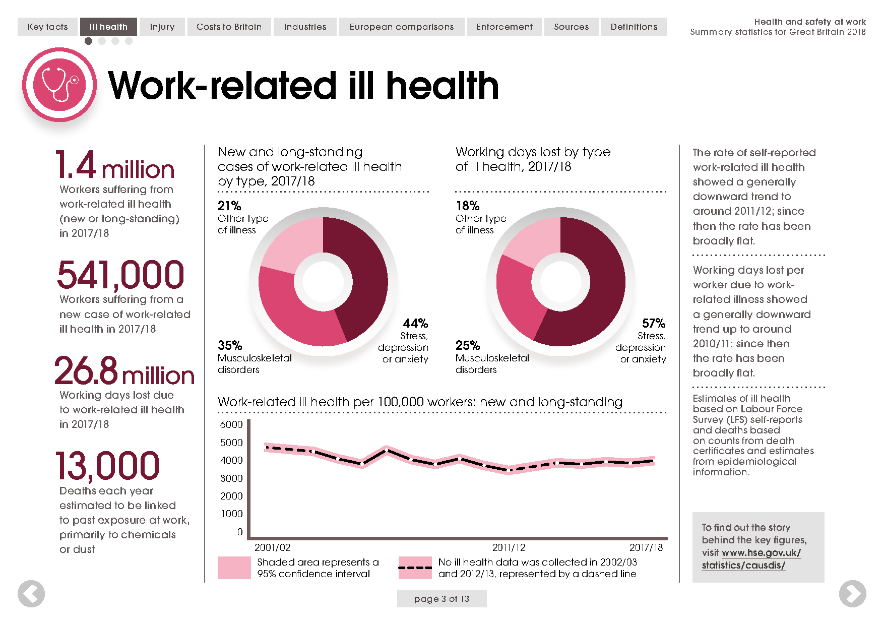

Slide 4
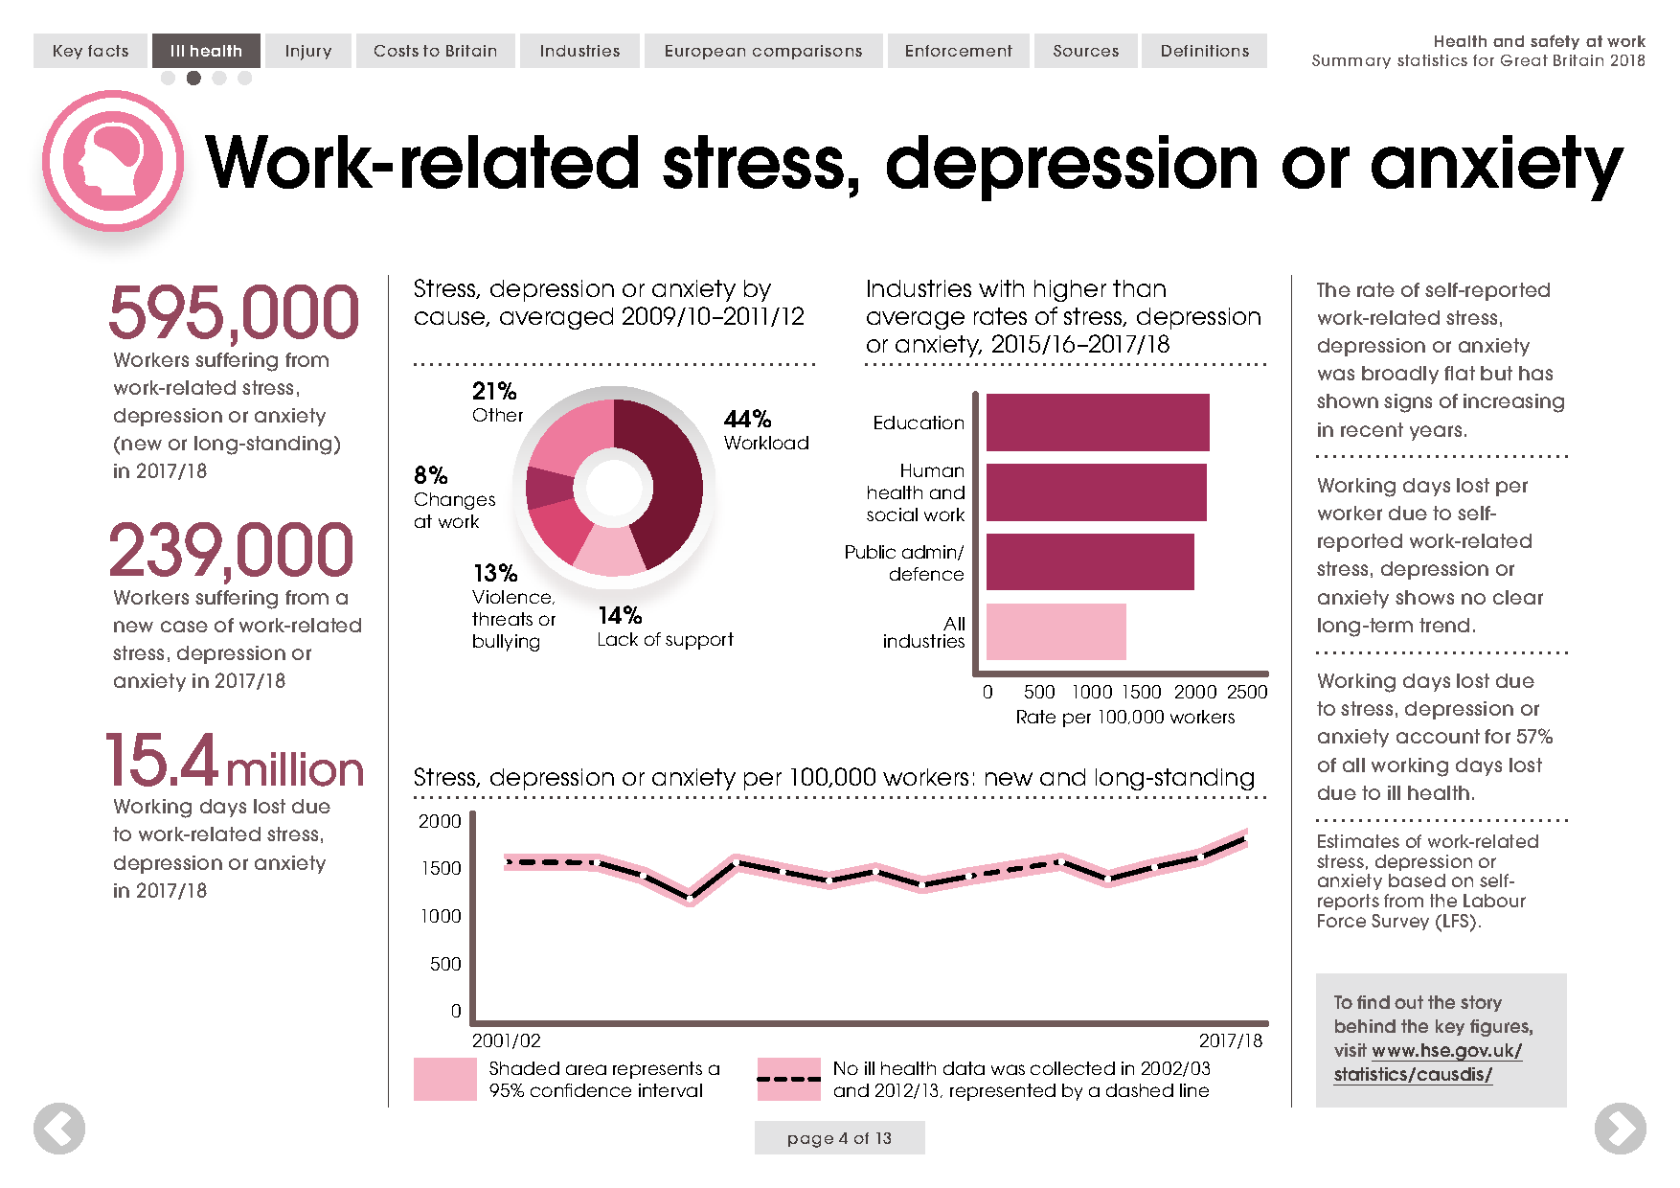

Slide 5
Estimated Annual Costs to UK Employers of Mental Ill-Health (Sainsbury Centre for Mental Health, 2007)
 | Cost per average employee (£) | Total cost to UK employers (£ billion) | Per cent of total
Absenteeism | 335 | 8.4 | 32.4
Presenteeism | 605 | 15.1 | 58.4
Turnover | 95 | 2.4 | 9.2
Total | 1035 | 25.9 | 100

Slide 6
Presenteeism
 | Health “Good” | Health “Not good”
No absences | Healthy & present | Unhealthy and present “Sickness Presentees”
Some absences | Healthy and not always present | Unhealthy and not always present

Slide 7
How common is sickness presenteeism?
 | Health “Good” | Health “Not good”
No absences | 35% | 28%
Some absences | 13% | 24%
N=39,000 employees from general working population (UK)

Slide 8
A Critical Business Issue
Mental health costs the UK £70bn per year, equivalent to 4.5% of GDP
Mental ill-health costs each employer £1,035 per employee, per year
15.2m sick days per year due to stress, anxiety or depression
Failure to unlock discretionary effort costs UK business £6bn
Only 2 in 5 employees working at peak performance
Notes:
Wealth of evidence to prove the business case:
£70bn to UK economy; 4.5% of GDP - OECD
£1,035 per employee, per year – Centre for Mental Health
To win the business case, focus on the opportunity cost – costs of doing nothing
Benefits of doing something
Bupa’s research into de-motivation in the workplace (Fit for Growth – research conducted 2013 with 5,000 workers):
Lack of motivation costs UK economy £6bn
Only 2 in 5 employees operating at peak level
Correlation between mental wellbeing, employee engagement, productivity
LINK: Not always treated as a strategic business priority , why?

Slide 9
Sources of Stress
Symptoms of
Stress
Disease
Intrinsic to the Job
Individual
Depressed mood
Excessive drinking
Irritability
Chest pains
High blood
pressure
Coronary heart
disease
Mental illness
Role in the
organisation
Relationships at
work
Individual
Career
development
Prolonged strikes
Frequent and
severe accidents
Apathy
Organisational
High absenteeism
High labour turnover
Poor quality control
Organisational
structure
and climate
Home/work
Interface

Slide 10
Intrinsic to the Job
Too much work - quantitative
- qualitative
Too little work
Time pressures and deadlines
Poor physical working conditions
Mistakes
Too many decisions

Slide 11
Variable Workload
High Workload
Poor Procedures by Pilots
Responsibility for Lives
Shiftwork Hours
Training Others
Stressed Air Traffic Controller
Increased Risk of Coronary Artery Disease

Slide 12
Role in the Organisation
Role ambiguity
Role conflict
Too little responsibility
Responsibility for People
Responsibility for things
Lack of managerial support
Organisational boundaries

Slide 13
Patients perceive as
inflictor of pain
Job interfering
with family life
DENTIST
Anxious
Personality
Coping with
difficult
patients
Trying to manage
a practice
Administrative duties

Slide 14
Relationships
Relationships with boss
Relationships with colleagues
Relationships with subordinates
Difficulties in delegating
Personality conflicts

Slide 15
Career Development
Over promotion
Under promotion
Lack of job security
Fear of redundancy or early retirement

Slide 16
Respondents Perceived Security in Current Job
(Source: CMI Economic Outlook April 2010)

Slide 17
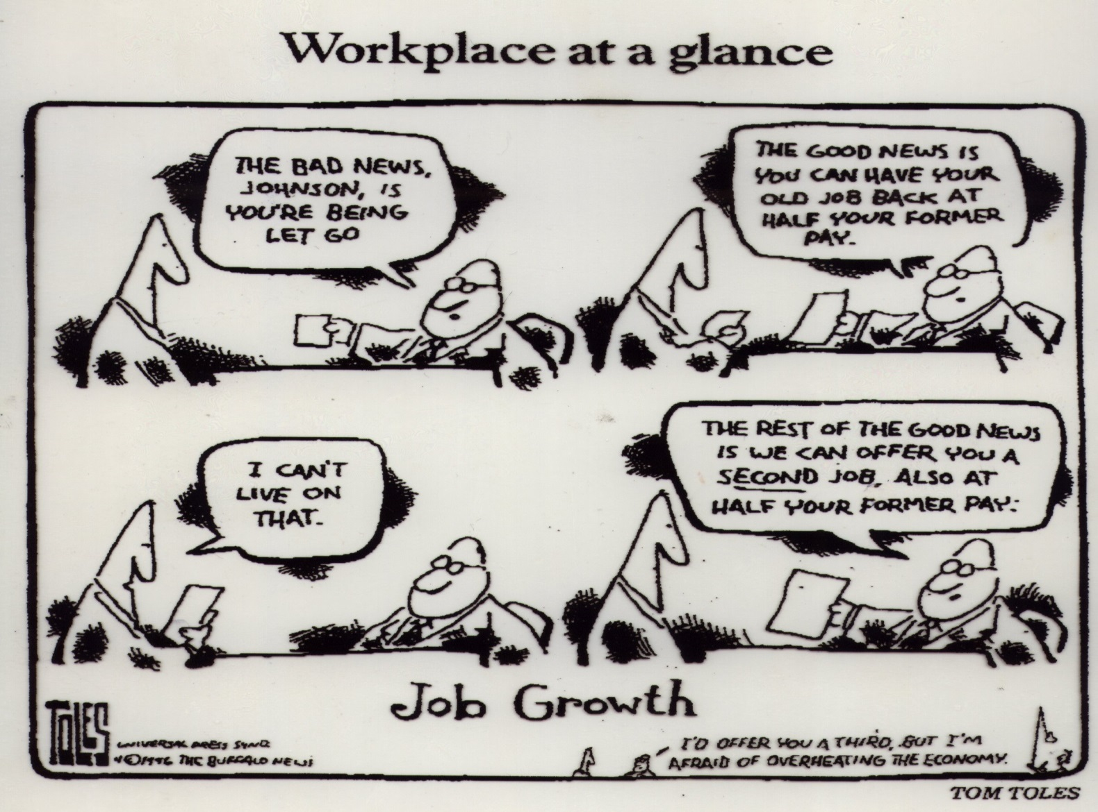

Slide 18
Organisational Structure and Climate
Restrictions on behaviour
No effective consultation or communication
Uncertainty
Loss of identity
Lack of participation

Slide 19
Organisation’s Interface with Outside
Divided loyalties
Conflict of work with family demands
Intrusion of problems outside
work-economic, life crisis

Slide 20
Comprehensive Programme
Interventions
Primary – Dealing with the stressors
Selection policies & induction
Workflow planning (task allocation, matching resource to work flow demand, etc)
Work Life Balance initiatives
Management Development Programmes
Secondary – Helping people to cope
Resilience training
Annual reviews & appraisals and personal development plans
Healthy Lifestyle & Well-being programmes
Tertiary – Picking people back up
Employee Assistance Programmes

Slide 21
CIPD Health and Wellbeing at work report, 2018:
Employers with a wellbeing initiative have: 44% better employee morale & engagement 31% lower sickness absence rate … 60% of organisations do not yet have a wellbeing strategy…

Slide 22
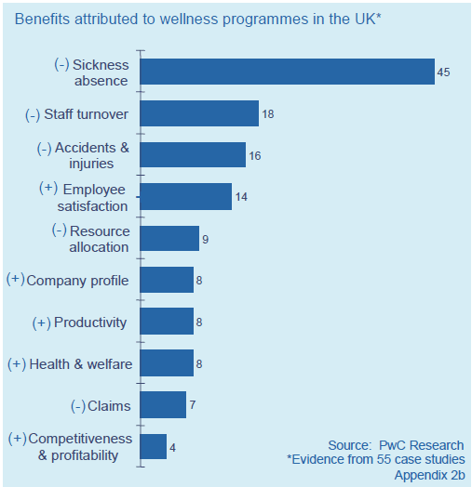
There is a business case for wellness programmes
Price Waterhouse Cooper Research based on 55 companies

Slide 23
Making the business case
If mental illness costs employers £28.3 billion per annum in 2009
Prevention and early identification of problems, should save employers at least 30% £8 billion per annum
www.nice.org.uk/nicemedia/pdf/PH22Guidance.pdf

Slide 24
