Slide 1
Engagement with the nationally implemented NHS Digital Diabetes Prevention Programme: Usage patterns over the 9-month programme duration
Rhiannon Hawkes, Lisa Miles, Ben Ainsworth, Jamie Ross, Rachel Meacock & David French
Division of Psychology and Mental Health Research Seminar 18th April 2023

Slide 2
A National Digital Diabetes Prevention Programme
2019:
Digital pathway introduced
Delivered by 4 digital provider organisations
2016:
Nationally implemented behaviour change programme
F2F group sessions
NHS England programme specification
2020:
Those referred offered choice between F2F and digital programme
Notes:
Digital interventions have the potential to address logistical challenges such as scheduling, travel, work and childcare, and they have the capacity to offer wide-reaching and tailored support at a lower cost, both of which are important for large-scale behaviour change.
Phone image ref: https://pxhere.com/en/photo/1087268 [free for commercial use]
Choice image ref: https://www.freepik.com/free-vector/electronic-paper-books-comparison_8609113.htm#query=online%20vs%20classroom&position=5&from_view=search&track=ais [free for commercial use]

Slide 3
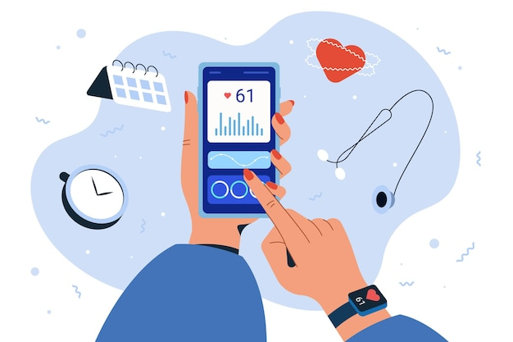
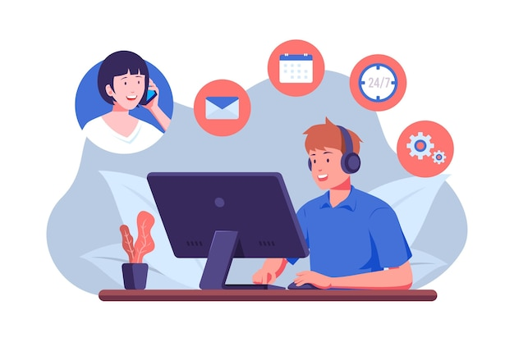
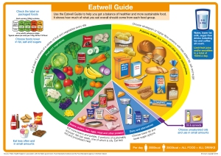
Digital Programme Delivery
App
Educational content
Health coaching
Notes:
This specification indicated key behaviour change techniques (BCTs) that should be present in the intervention. The use of BCTs to self-regulate behaviours (e.g. goal setting, self-monitoring) were particularly emphasised in the specification.
There are various modes of delivery that intervention content can be delivered:
App delivery (e.g. tracking, setting goals, group support forums)
Educational content (e.g. articles, videos, podcasts, links to websites)
Delivery via health coach support (e.g. via telephone support or one-to-one messaging)
Service provision differs across providers (e.g. some have more emphasis on health coach support, others on group support, etc.)
App image ref: https://www.freepik.com/free-vector/flat-smartphone-smart-watch-monitoring-heart-rate_23824401.htm#query=mobile%20health%20app&position=4&from_view=search
Health coaching image ref: https://www.freepik.com/free-vector/organic-flat-customer-support-illustration_13184987.htm#query=customization&position=0&from_view=keyword

Slide 4
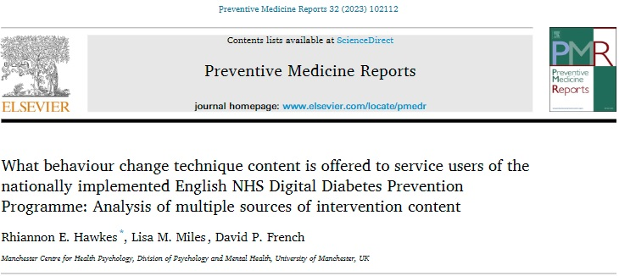
Service Delivery and Fidelity
In their digital programmes, providers offered 80% of key intervention content in the NHS programme specification.
43% via app delivery 74% via educational materials 62% via health coaching
But to what extent do users engage with this content?
Hawkes et al., 2023. What behaviour change technique content is offered to service users of the nationally implemented English NHS Digital Diabetes Prevention Programme: Analysis of multiple sources of intervention content. Preventive Medicine Reports, 32;102112.
Notes:
Programme of work has been evaluating fidelity of the F2F and digital DPP services, including design, training, delivery and receipt.

Slide 5
Research Aims and Objectives
To understand engagement with the NHS DDPP for a cohort of service users enrolled with 3 NHS DDPP providers over the nine-month programme duration
Describe duration of engagement on the app
Describe overall frequency of use of programme features
Describe patterns across time in engagement with programme features over the nine-month programme duration
Compare any differences in engagement with programme features between NHS DDPP providers over time

Slide 6
Methods
Obtained routinely collected usage data from 1,826 users enrolled on the DDPP between December 2020-June 2021 for 3 providers
Engagement with key intervention features of the DDPP:
Self-monitoring
Goal setting
Receiving information (via educational articles)
Social support (via health coach and group forum)
And time spent on app
 | Provider A | Provider C | Provider D
Cohort of service users (date range) | New registrants starting NHS DDPP between 20/05/2021 and 19/06/2021 | New registrants starting NHS DDPP between 01/12/2020 and 28/02/2021 | New registrants starting NHS DDPP between 01/12/2020 and 28/02/2021
No. of service users | 940 | 283 | 603
Notes:
One of the providers (provider B) could not supply usage data to the research team.
Providers are labelled A, C and D to allow cross-reference with previous published work.

Slide 7
Results: Time spent on app
App usage decreased over time across the providers
Variation identified in engagement across provider programmes → identify programme features that promoted engagement
Notes:
App usage declined from a median of 32 minutes (IQR 191) in month one to 0 minutes (IQR 14) in month nine. The magnitude of this decrease varied substantially between providers.

Slide 8
Results: Self-monitoring
Users primarily used the apps to self-monitor behaviours (e.g. PA, diet) and access educational content
Self-monitoring:
Notes:
Self-monitoring of behaviours (e.g. physical activity, diet) was used a median of 117 times (IQR 451) over the nine-month programme.
The group discussion forums were utilised less regularly (accessed a median of 0 times at all time-points).

Slide 9
Results: Educational content
Users primarily used the apps to self-monitor behaviours (e.g. PA, diet) and access educational content
Educational content:
Notes:
Self-monitoring of behaviours (e.g. physical activity, diet) was used a median of 117 times (IQR 451) over the nine-month programme.
The group discussion forums were utilised less regularly (accessed a median of 0 times at all time-points).

Slide 10
Results: Health coach support
User engagement findings | Provider programme feature
Self-monitoring
Users on provider C’s programme more frequently self-monitored their behaviours. | Messages from their health coach with tailored feedback on behaviours monitored.
Goal setting
Users on provider A’s programme set or amended goals more frequently throughout the nine-months. | Monthly telephone calls with a health coach.
Group support
Users on provider D’s programme sent more peer messages via the group chat during the first three months of the programme. | The closed group chats were moderated by health coaches for the first three months of the programme.
Notes:
User engagement differences between providers and possible explanatory differences in provider programme features.

Slide 11
Summary
Differences in engagement likely due to programme differences across provider (particularly health coach support)
App usage decreased over 9 months, but magnitude of decrease varied across providers
Users primarily used the app to self-monitor behaviours and access educational content, group support content rarely used
Health coach support that was linked to specific features (e.g. goal setting and self-monitoring) was associated with higher engagement with that intervention feature
Notes:
Analysis of the different features used in the NHS-DDPP allowed further understanding of the breadth of NHS-DDPP app engagement.
This was possible as we analysed usage data from three different providers. We can therefore conclude that differences in engagement identified in this analysis are likely due to programme differences.
There are some clear differences between providers which appear likely candidates for this variation in engagement (particularly health coach support).

Slide 12
Implications
Engagement followed similar usage pattern seen in trials of digital DPPs, and compares favourably with F2F DPP
This study highlights what intervention features users engaged with → engagement is linked with intervention effectiveness
Literature suggests group support associated with weight loss in digital DPPs – users in DDPP missing out on key intervention component?
Need to look at associations between programme feature usage and outcomes
Importance of human element in digital behaviour change interventions
Notes:
Engagement followed similar usage pattern seen in trials of digital DPPs, including patterns of attrition and engagement with programme features such as self-monitoring.
Engagement also compared favourably with the F2F programme.
Previous research assessing engagement with the face-to-face NHS-DPP found that 34% of service users completed 60% of the programme, and 22% of service users went on to complete the full course.
The current literature also suggests that group support is associated with weight loss in digital diabetes prevention programmes. Lack of group interaction might indicate that users are missing out on a key intervention component – thus might be fruitful for providers to try and increase user engagement with this programme feature. Provider that offered closed peer group chats (akin to WhatsApp) that was moderated by a health coach elicited more engagement compared to the open group discussion forums (akin to Facebook).

Slide 13
Outputs from the evaluation of the NHS DDPP
Hawkes RE, Miles LM, French DP. Fidelity to programme specification of the National Health Service Digital Diabetes Prevention Programme behaviour change technique content and underpinning theory: Document analysis. J Med Int Res. 2022;24(4):e34253.
Miles LM, Hawkes RE, French DP. Description of the nationally implemented National Health Service Digital Diabetes Prevention Programme intervention and rationale for its development: Mixed methods study. BMC Health Services Res.
Hawkes RE, Miles LM, French DP. What behaviour change technique content is offered to service users of the nationally implemented English NHS Diabetes Prevention Programme: Analysis of multiple sources of intervention content. Preventive Medicine Reports. 2023;32:102112.
Miles LM, Hawkes RE, French DP. How is the behaviour change content of a nationally implemented Digital Diabetes Prevention Programme understood and used by participants? A qualitative study of fidelity of receipt and enactment. J Med Int Res. 2023;25:e41214.
Hawkes RE, Miles LM, Ainsworth B, Ross JA, Meacock R, French DP. Engagement with a nationally-implemented digital behaviour change intervention: Usage patterns over the 9 month duration of the National Health Service Digital Diabetes Prevention Programme. Under review.
Cheung WC, Miles LM, Hawkes RE, French DP. Experiences of online group support for engaging and supporting participants on the National Health Service Digital Diabetes Prevention Programme: A qualitative interview study. Under review.
Evans TE, Hawkes RE. Working with stakeholders to translate health psychology research into practice: Reflections from evaluations of two national behaviour change programmes. Under review.

Slide 14
Acknowledgements
This research is funded by the National Institute for Health and Care Research (Health and Social Care Delivery Research (HSDR) Programme, 16/48/07 – Evaluating the NHS Diabetes Prevention Programme (NHS DPP): the DIPLOMA research programme (Diabetes Prevention – Long Term Multimethod Assessment))
The views and opinions are those of the authors and do not necessarily reflect those of the National Institute for Health and Care Research or the Department of Health and Social Care.
For more information about DIPLOMA:
www.clahrc-gm.nihr.ac.uk/projects/diploma-evaluation-national-nhs-diabetes-prevention-programme
Rhiannon.Hawkes@manchester.ac.uk
@RhiannonHawkes
Notes:
Image ref: https://pixabay.com/illustrations/mail-message-email-send-message-1454731/ [free for commercial use].

